Slide 1
ALGEBRA 4
Day 61

Slide 2
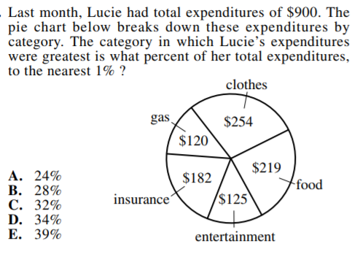
Bell Work

Slide 3
ACT DAY 1
Basic understanding of the ACT.
How do they score the ACT?
John Baylor Math Formulas and Tips
Formula Sheet (before spring break… extra)
Mini Test 1

Slide 4
ACT ASSESSMENT
This test is used by colleges to predict students’ success in college courses.

Slide 5
What types of questions are on the ACT?
Based on subjects studied in high school
Emphasizes thinking skills
Does not ask you to recall facts or memorize information
Questions require students to solve problems, draw conclusions, make inferences, think analytically

Slide 6
How long does the test take?
The test takes 2 hours and 55 minutes to complete
It consists of 215 multiple-choice questions in 4 areas:
English
Math
Reading
Science reasoning
OPTIONAL: 30-minute writing test

Slide 7
What is the highest possible score?
36
You will receive a score for each section of the test and those will be averaged together.

Slide 8
Is it okay to guess?
Your score on the test will be based on the number of questions that you answer correctly
THERE IS NO PENALTY FOR GUESSING!
Answer every question, even if you have to guess

Slide 9
May I use a calculator on the math portion of the test?
Is it okay for me to assume you want the graphing calculator that we use in class?
Otherwise they’ll give you the normal one

Slide 10
How many questions are on the English test?
TOTAL OF 75 questions, 45 minutes
Usage and Mechanics (40 questions)
Punctuation 10
Grammar 12
Sentence Structure 18
Rhetorical Skills (35 questions)
- Writing Strategy 12
- Organization 11
- Style 12

Slide 11
How many questions are on the math test?
TOTAL OF 60 questions, 60 minutes
Pre-algebra 14
Elementary algebra 10
Intermediate algebra 9
Coordinate geometry 9
Plane geometry 14
Trigonometry 4

Slide 12
How many questions are on the reading test?
TOTAL OF 40 questions, 40 minutes
Prose fiction: novels, short stories 10
Social studies 10
Humanities 10
Natural Science 10

Slide 13
How many questions are on the science reasoning test?
TOTAL OF 40 questions, 35 minutes
Data representation (graphs, tables): 15
Research summaries (experiments): 18
Conflicting viewpoints (inconsistent hypotheses): 7

Slide 14
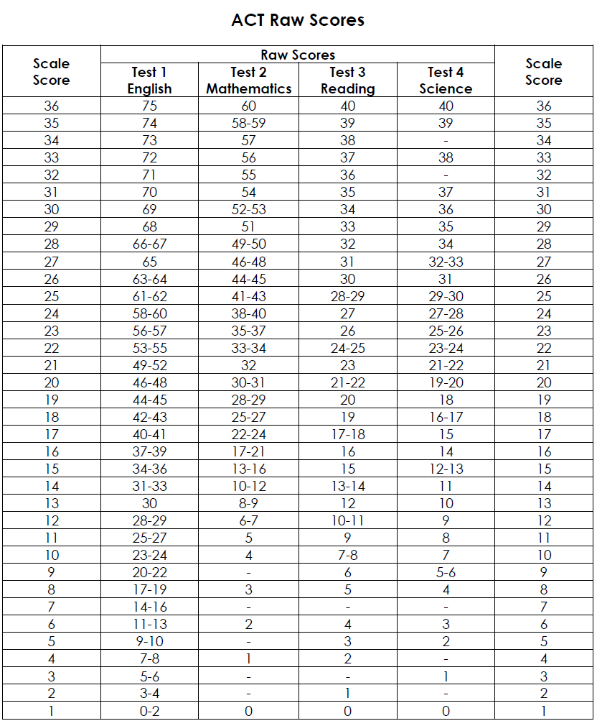

Slide 16
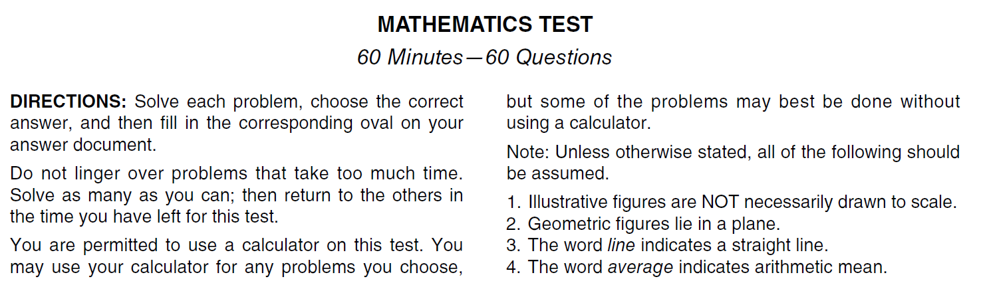
Read the Directions before the Test Day

Slide 17
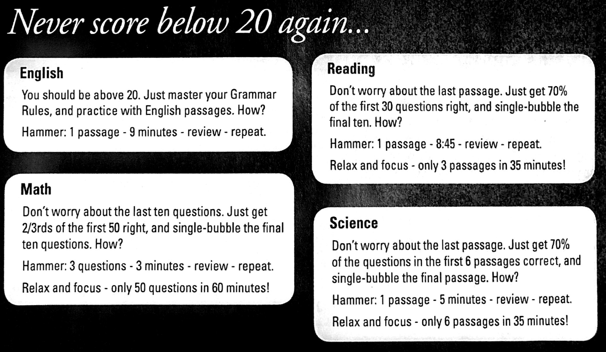

Slide 18
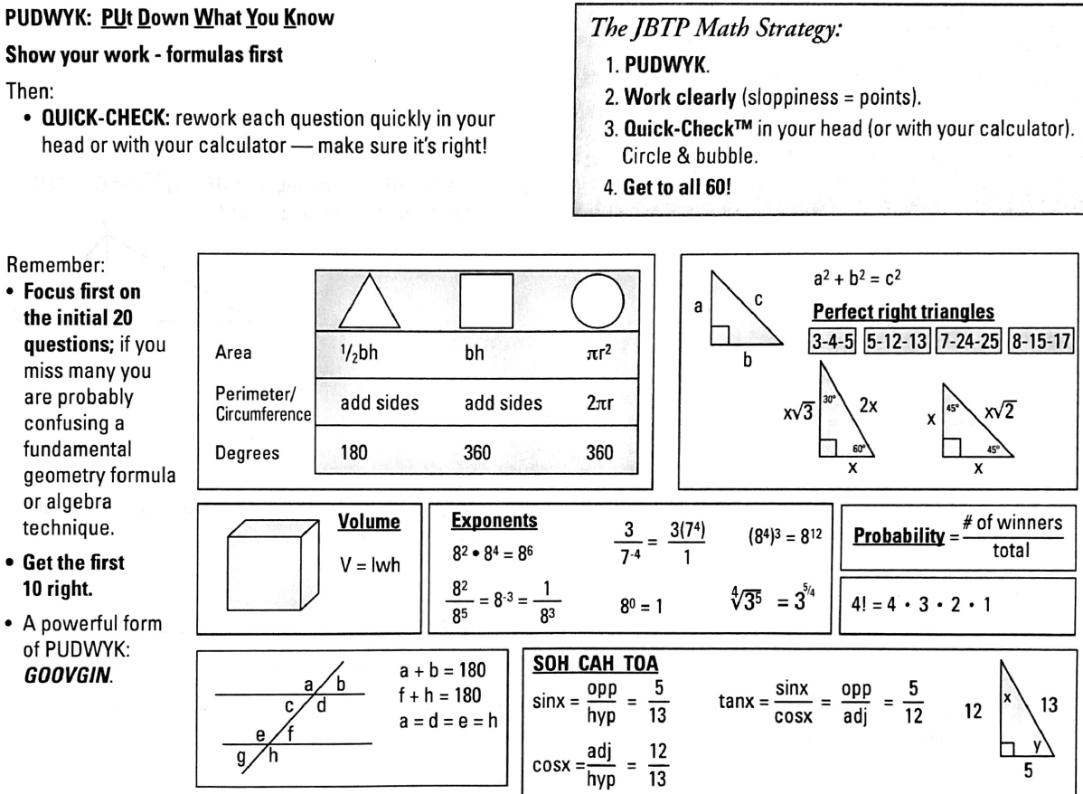

Slide 19
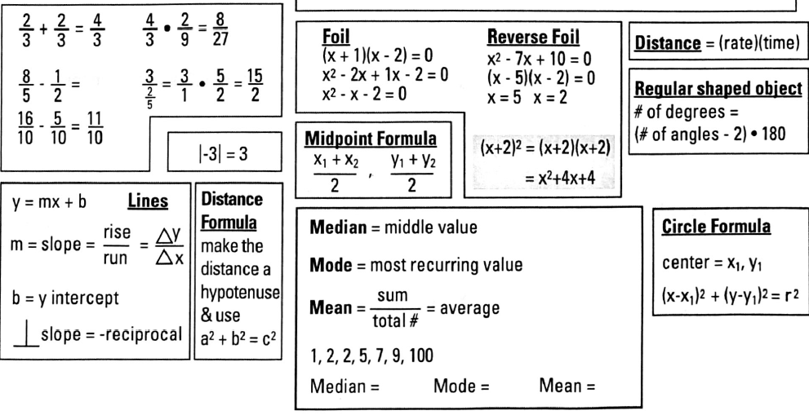

Slide 20
Mini Test 1

